Slide 1




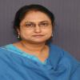
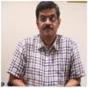
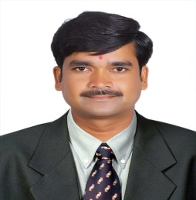
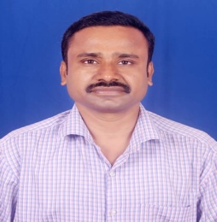
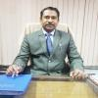
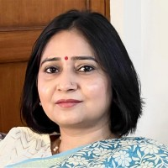
INDIRA GANDHI NATIONAL OPEN UNIVERSITY
Regional Centre Delhi-3
National Level Orientation Programme on
Social Work Practicum for BSWOL Learners
and Academic Counsellors
Prof. Uma Kanjilal
Hon’ble Vice Chancellor,
IGNOU
Date:- 14th November, 2024
Time:- 12 Noon
Google Meet Link:- meet.google.com/qei-dkyh-wbb
Dr. Umesh Chandra Pandey
Director,
Regional Services Division
Prof. Saumya Pandey
Director,
School of Social Work
Dr. K. Linga Swamy
Programme Coordinator
School of Social Work
Dr. V. Kannappa Setty Programme Coordinator
School of Social Work
Dr. Ashok Sharma
Sr. Regional Director,
IGNOU, RC Delhi-3

